Slide 1
Water filters
Community impact + environment

Slide 2
Why is clean water an issue?
Lots of people don’t have access to clean water
1.1 billion people don’t have access to clean water
2.7 billion experience water scarcity (don’t have enough water) one month per year
Drinking water needs to be clean for us to be safe
Dirty water can have harmful chemicals, bugs and dirt in that can make us ill

Slide 3
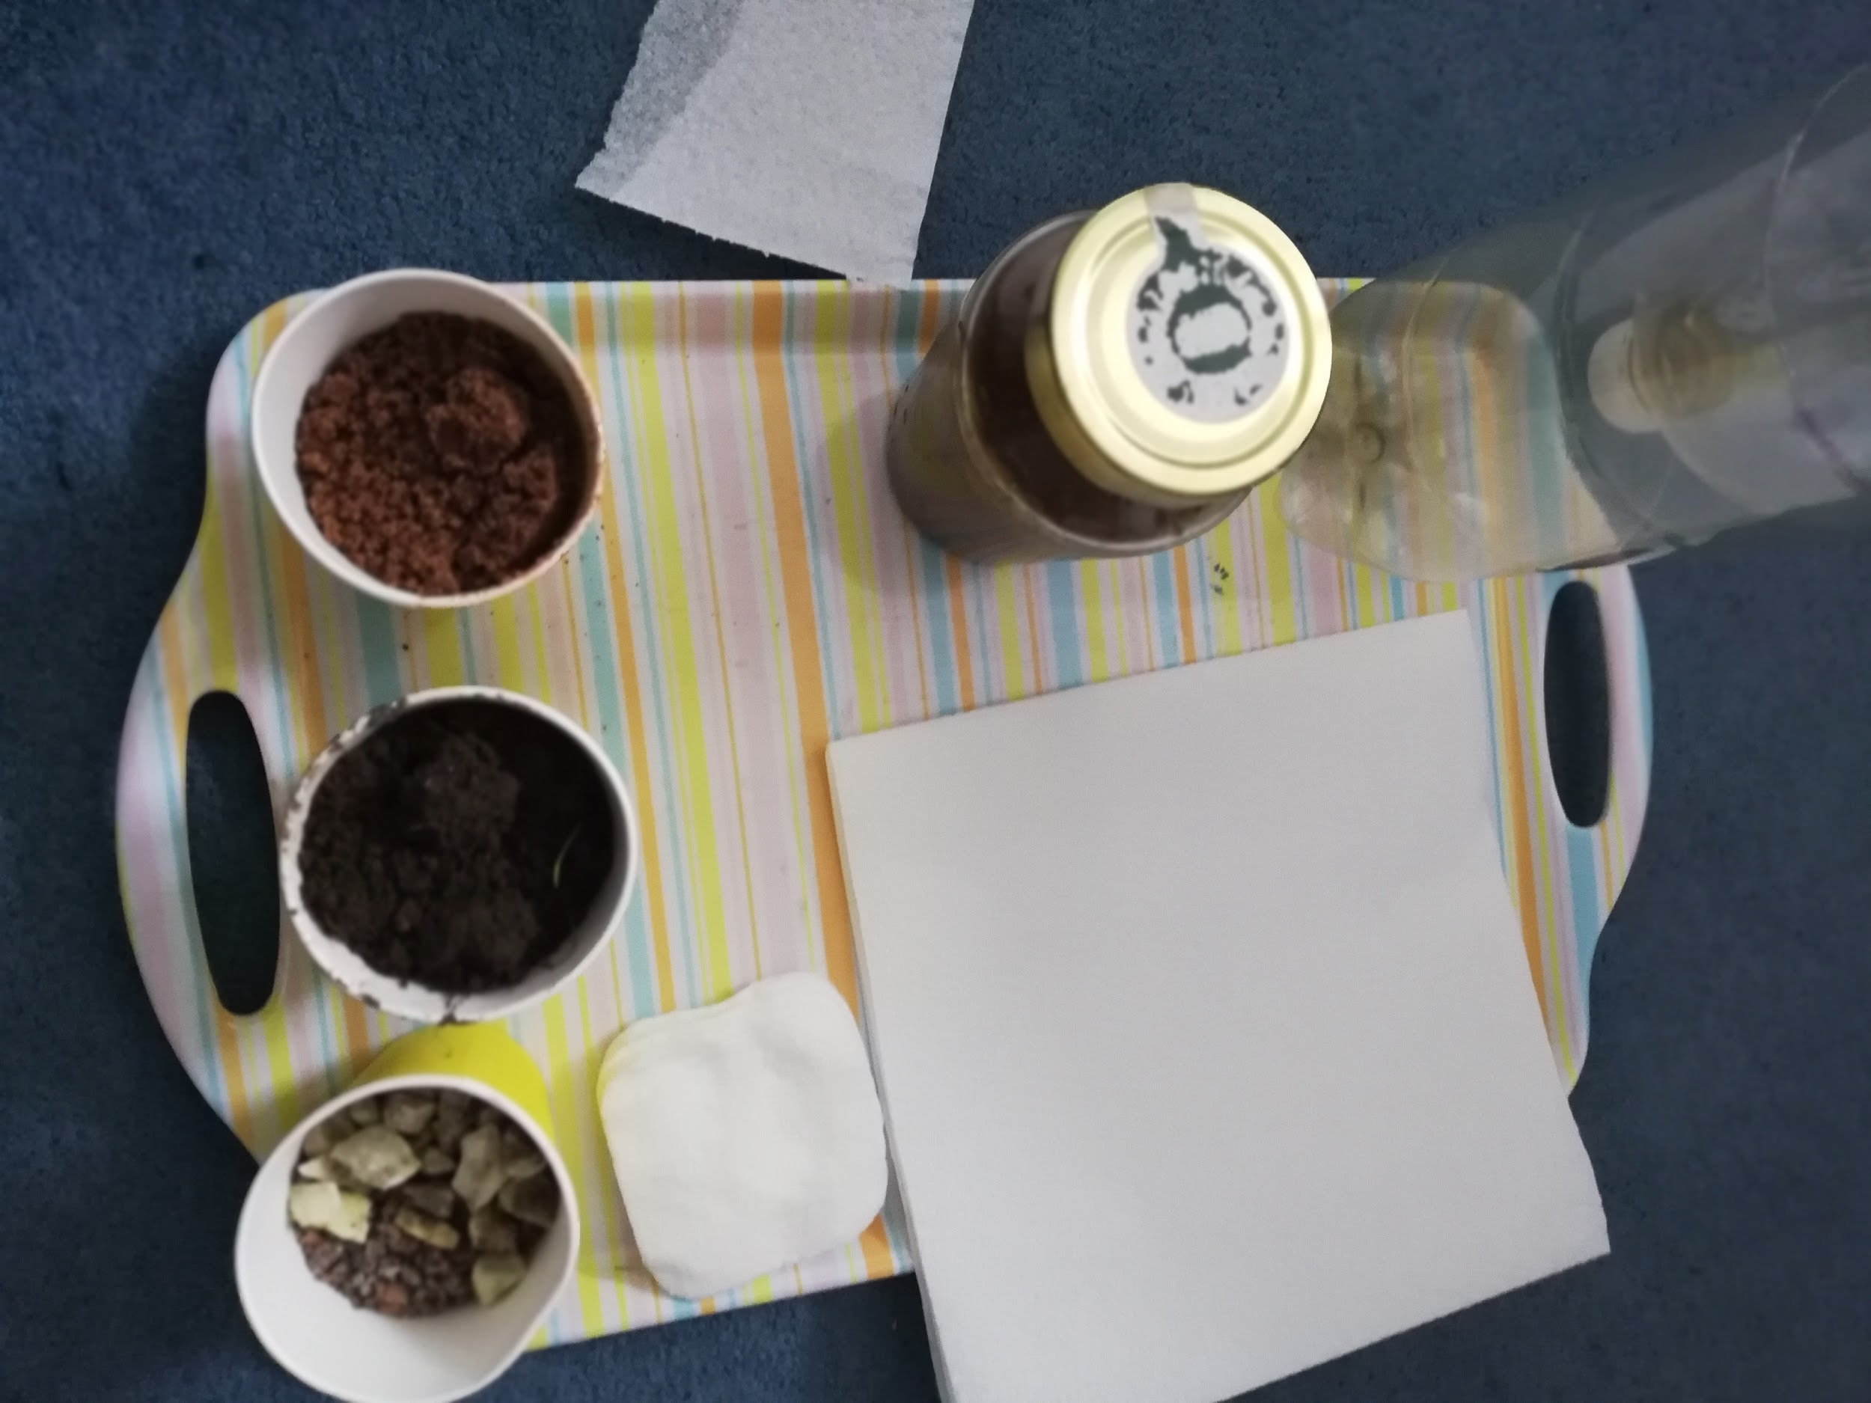
Making a water filter
Plastic Bottle
Napkins ( or Kitchen roll)
Muddy Water
Cotton Wool
Sand
Gravel
Soil
Tray

Slide 4
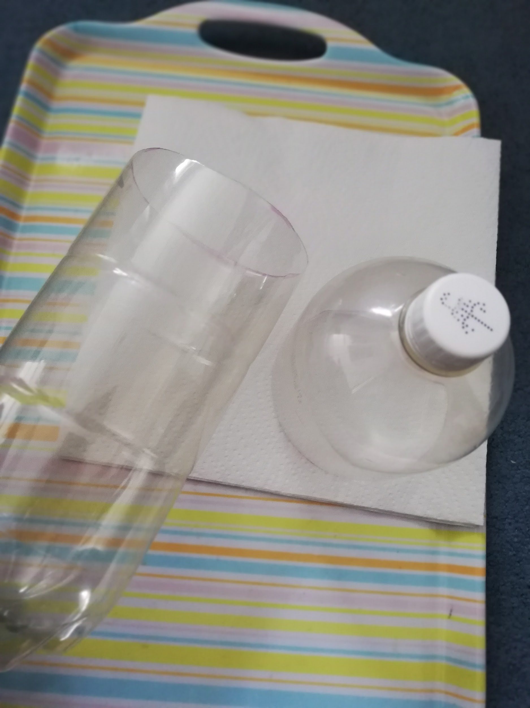
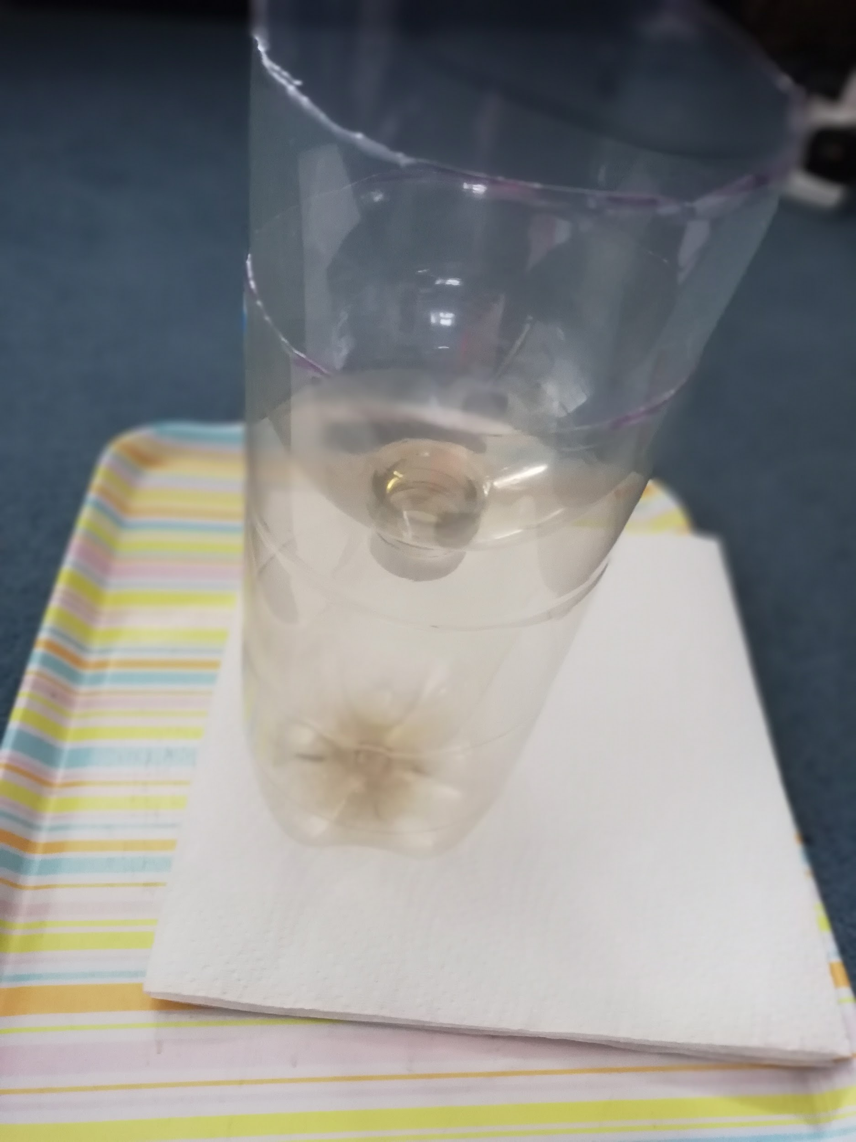
Cut the bottle if you haven’t already (parents)
Once you’ve cut it put the top part upside down in the other
Make sure you ask a parent because this is a little bit tricky

Slide 5
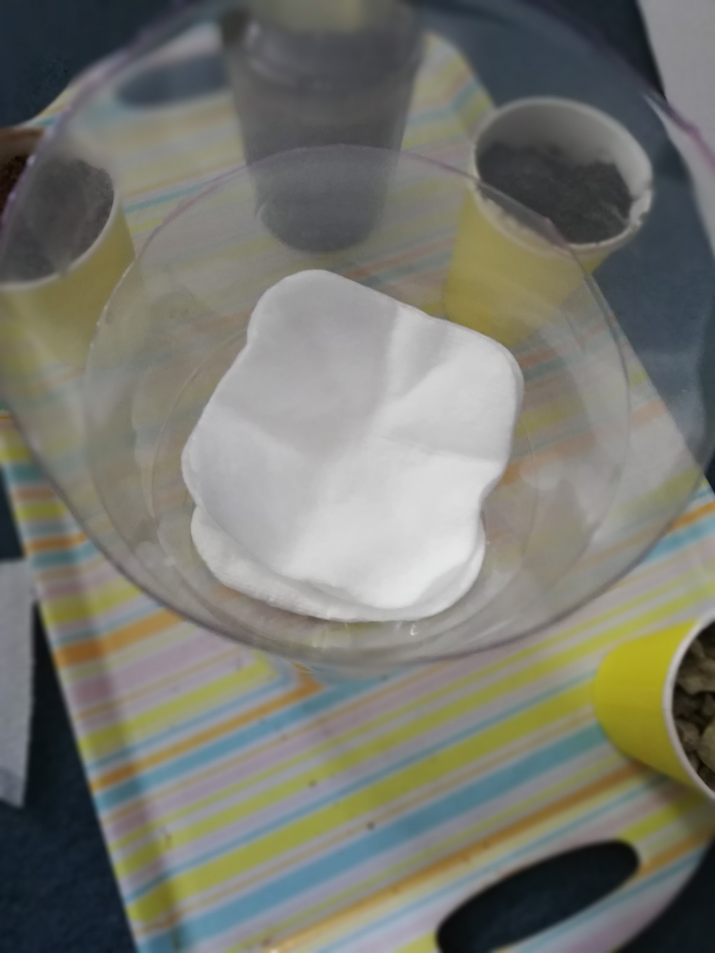
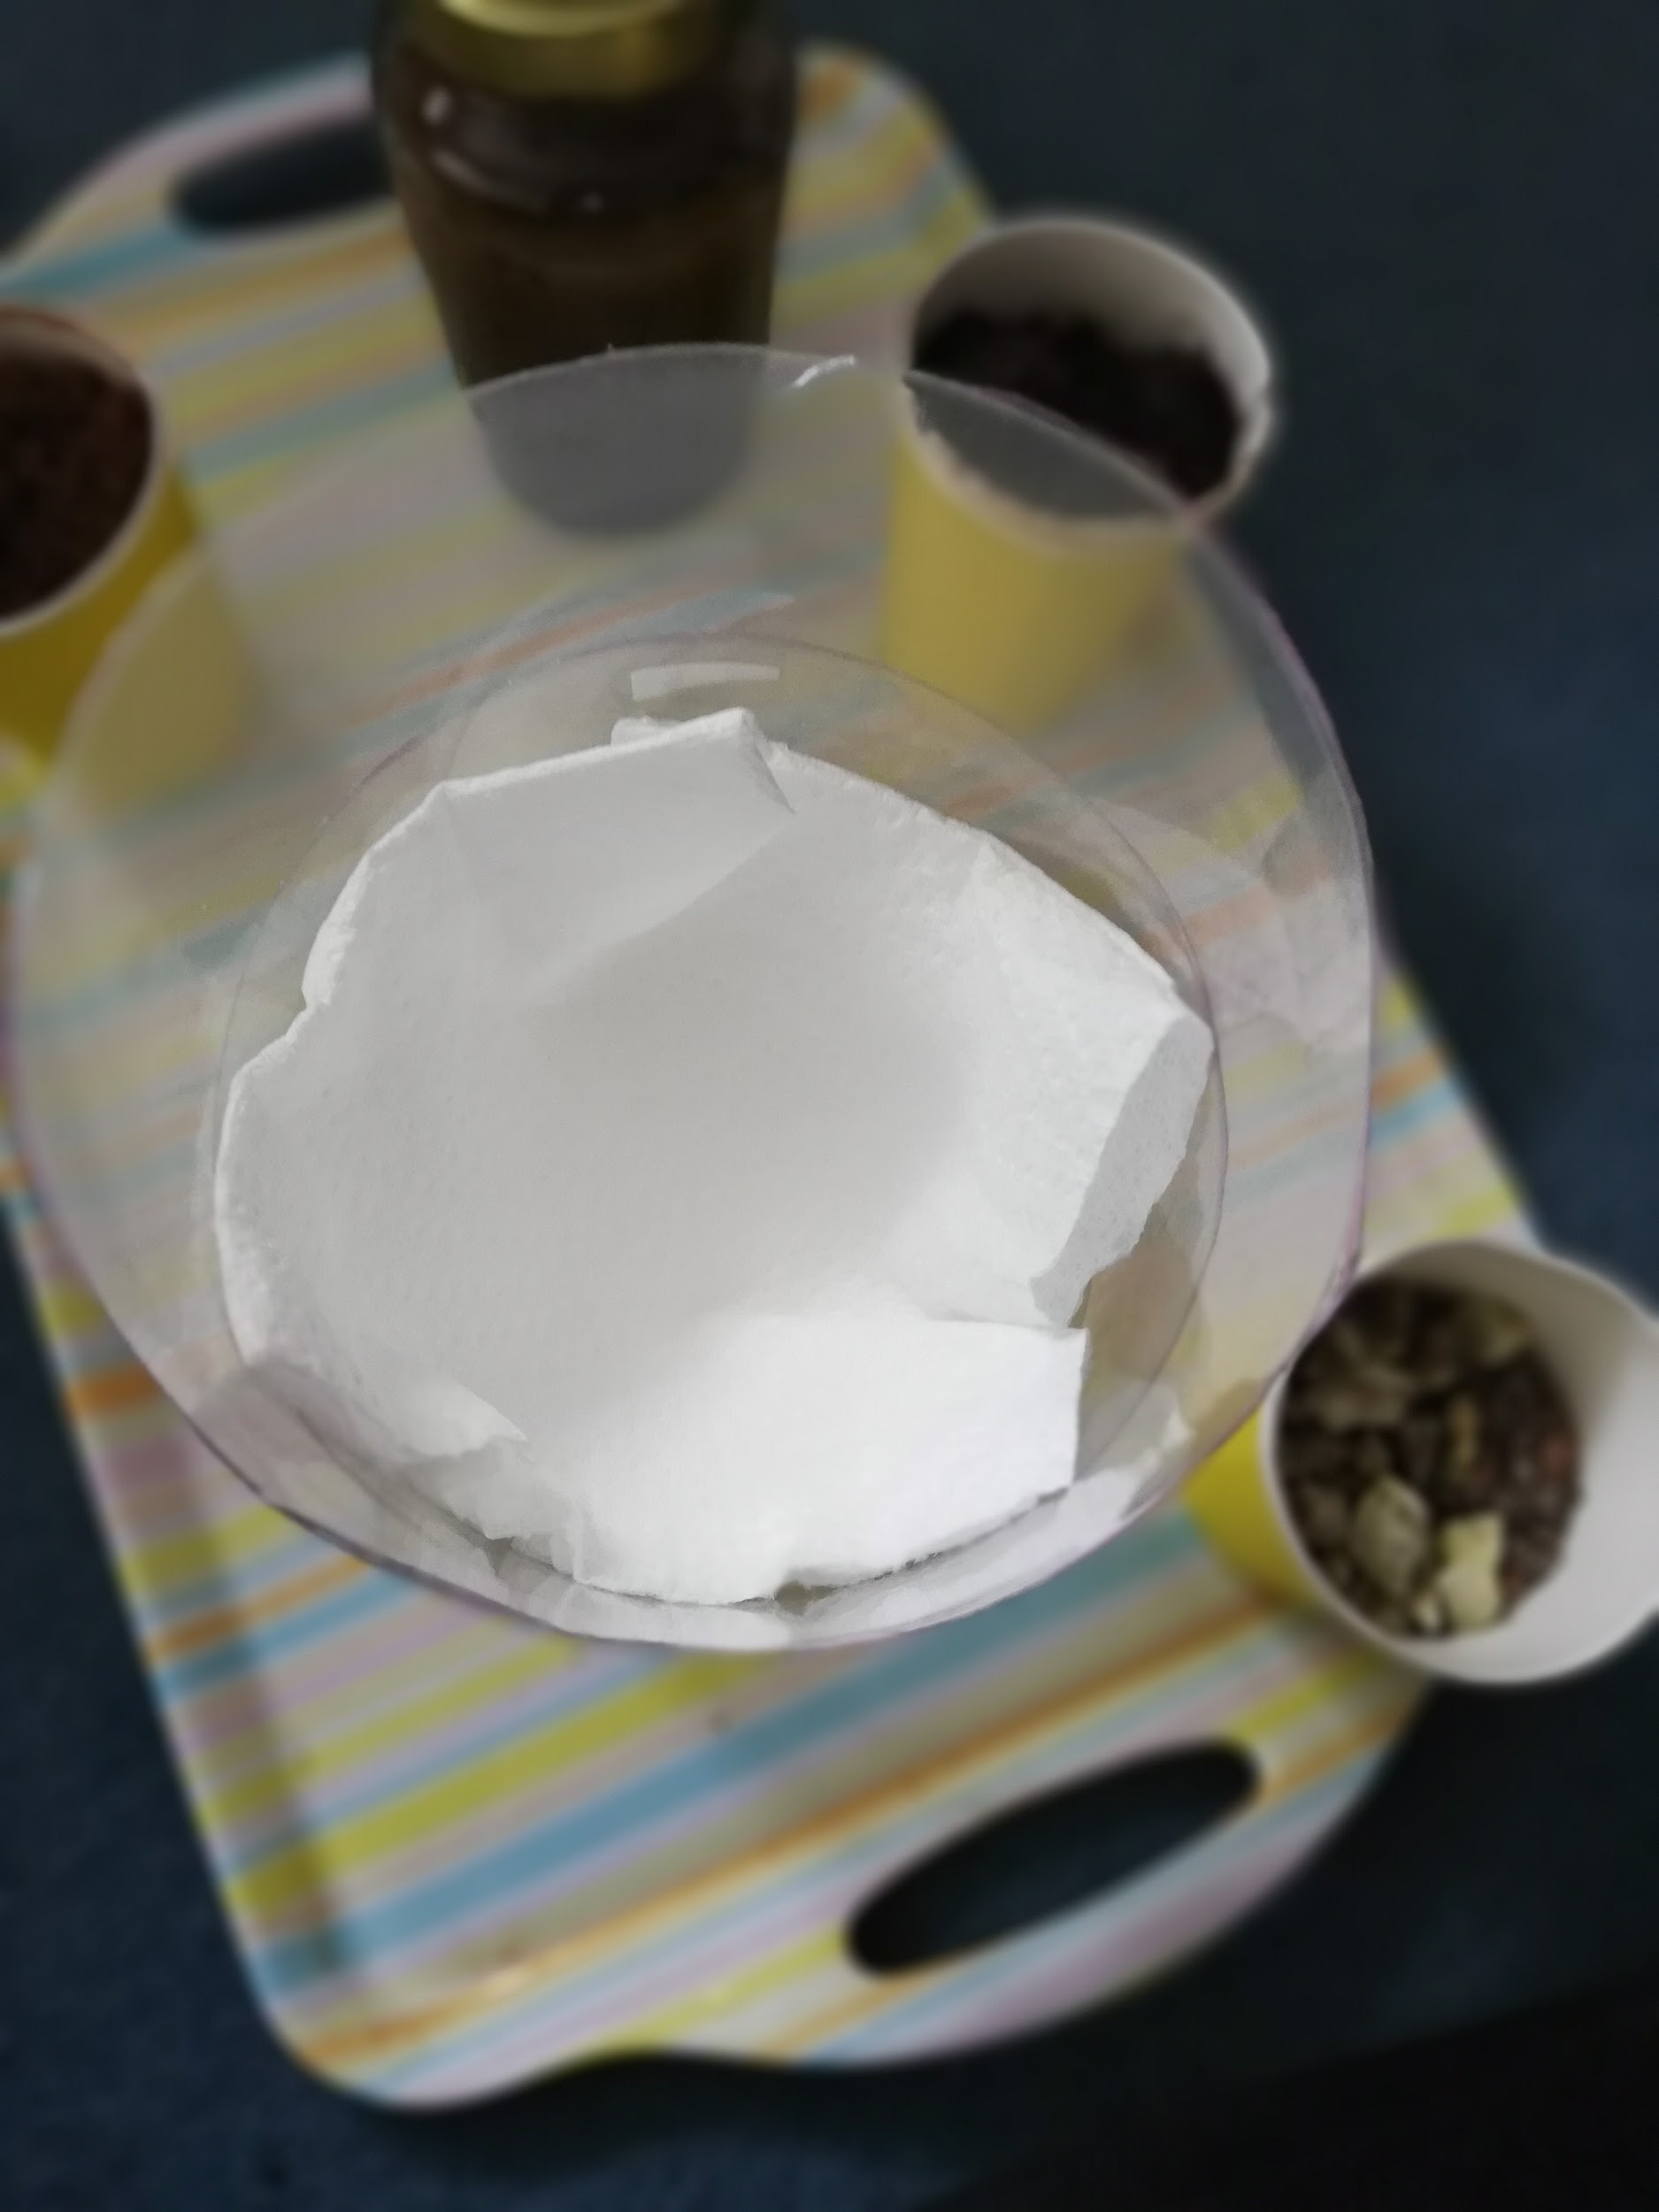
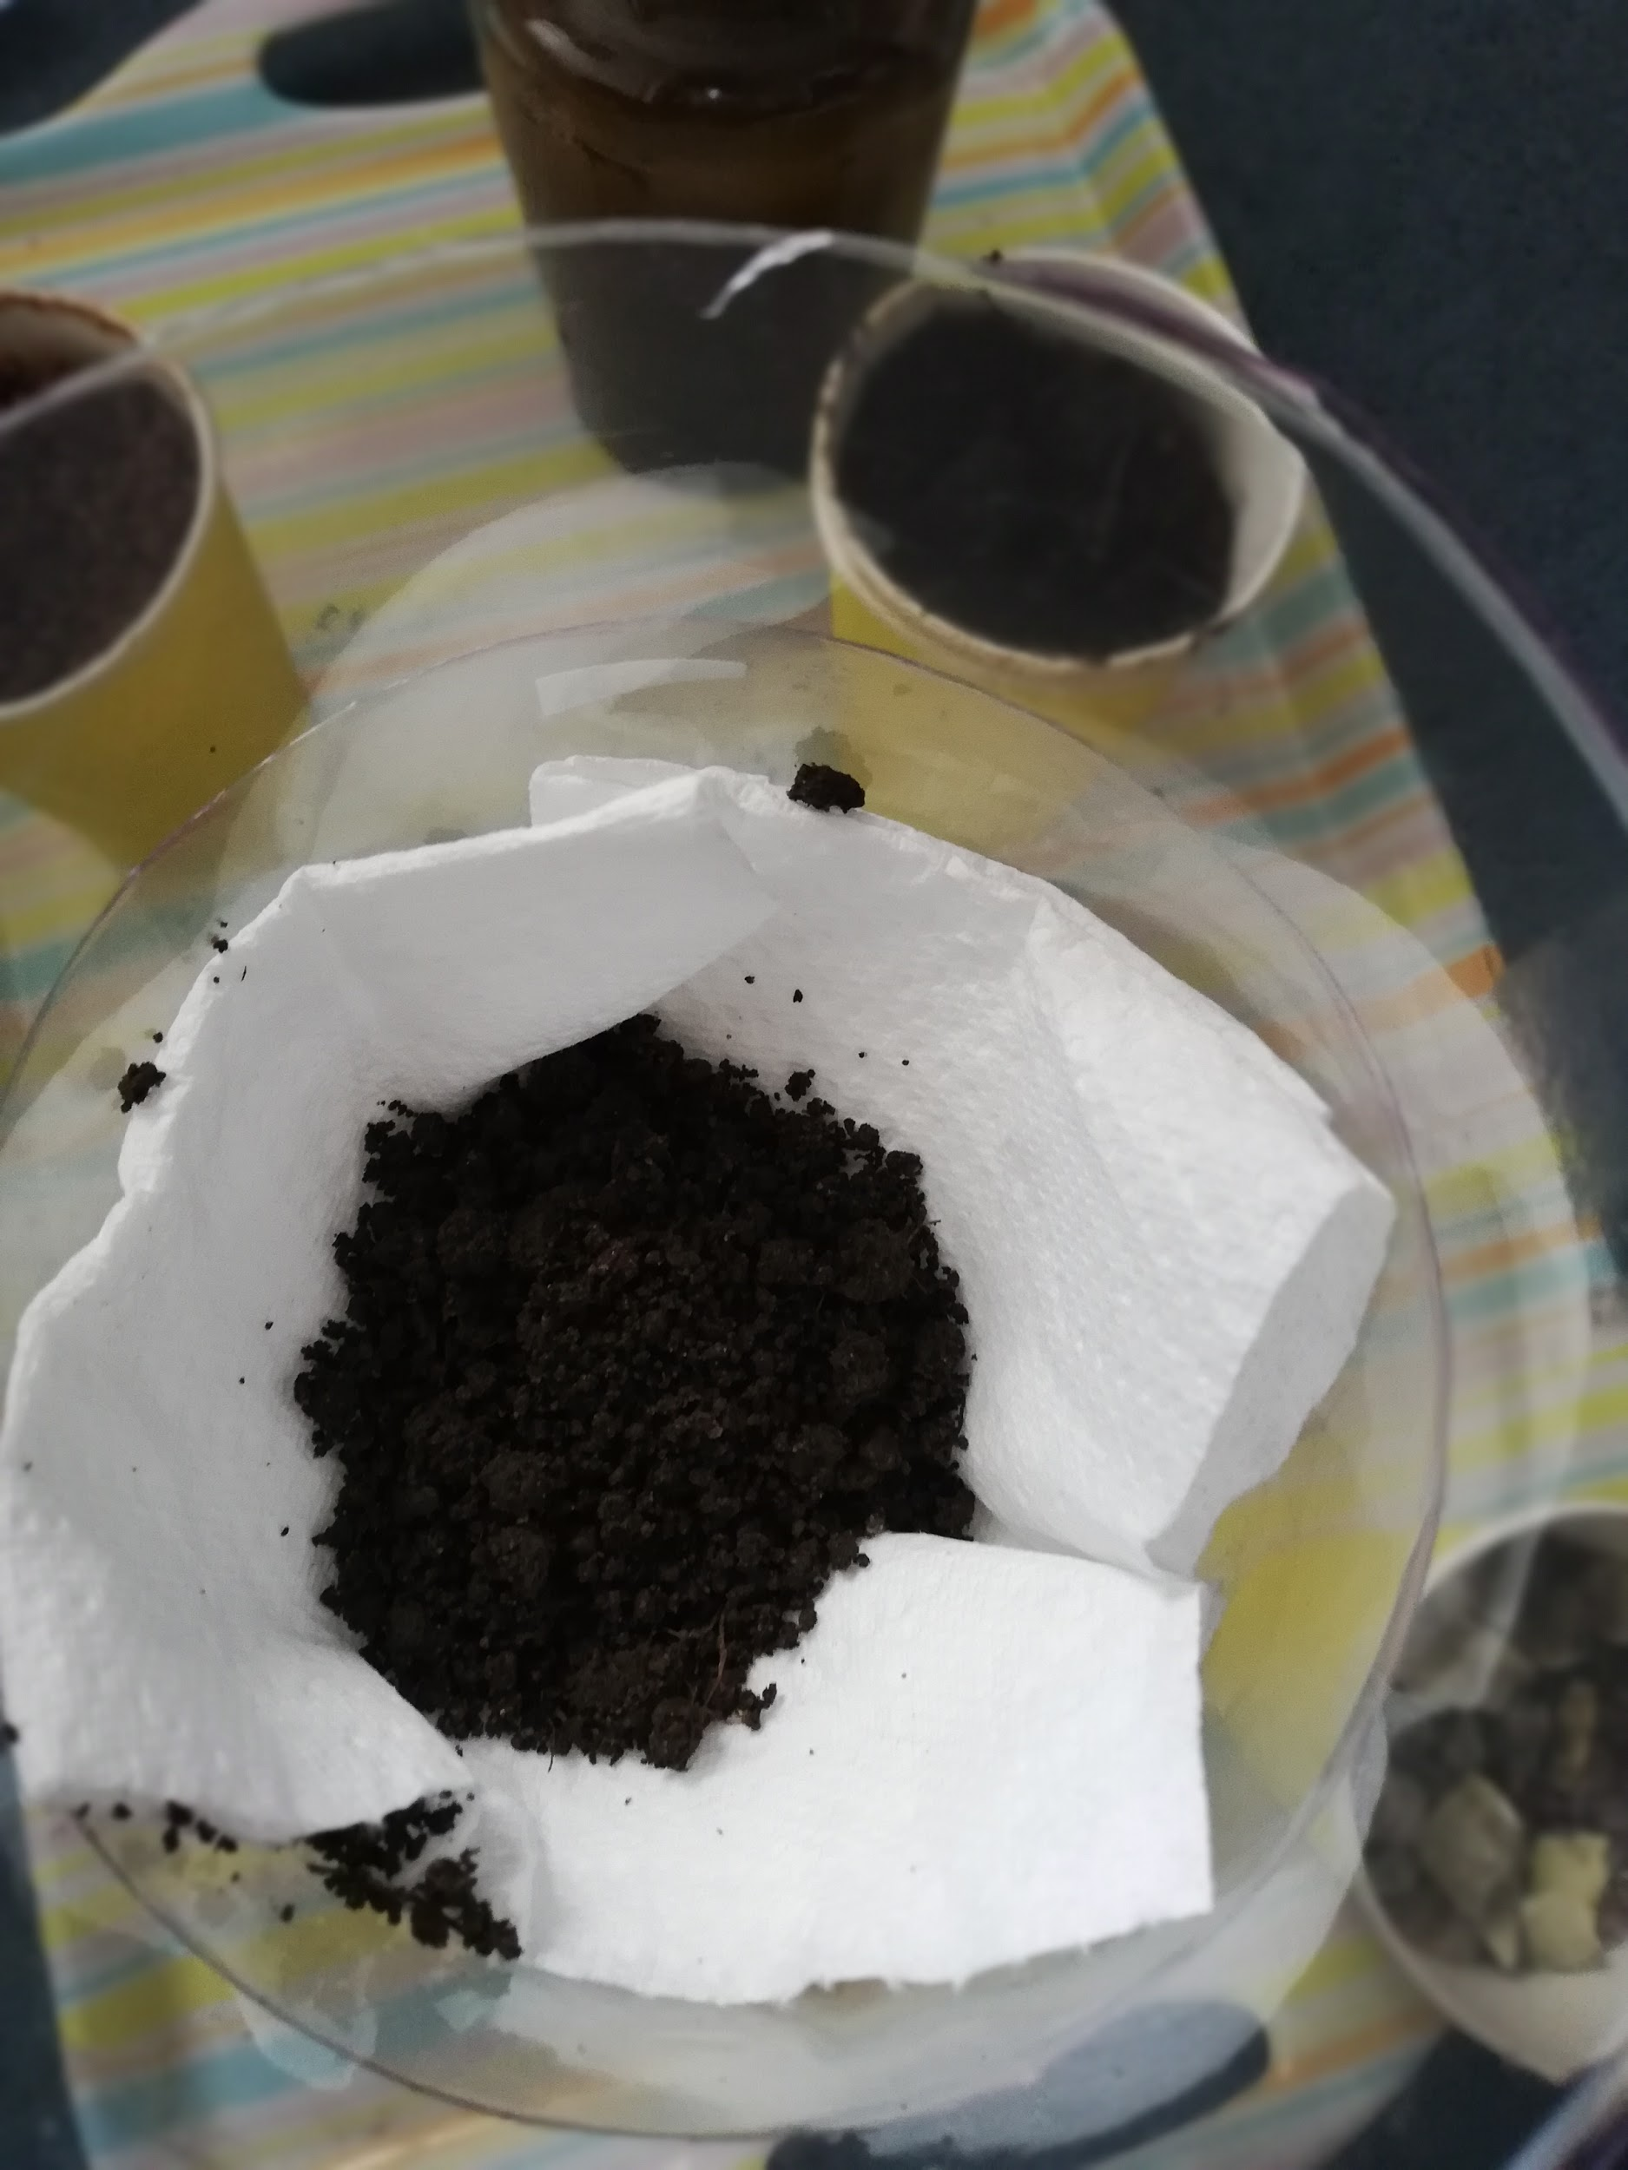
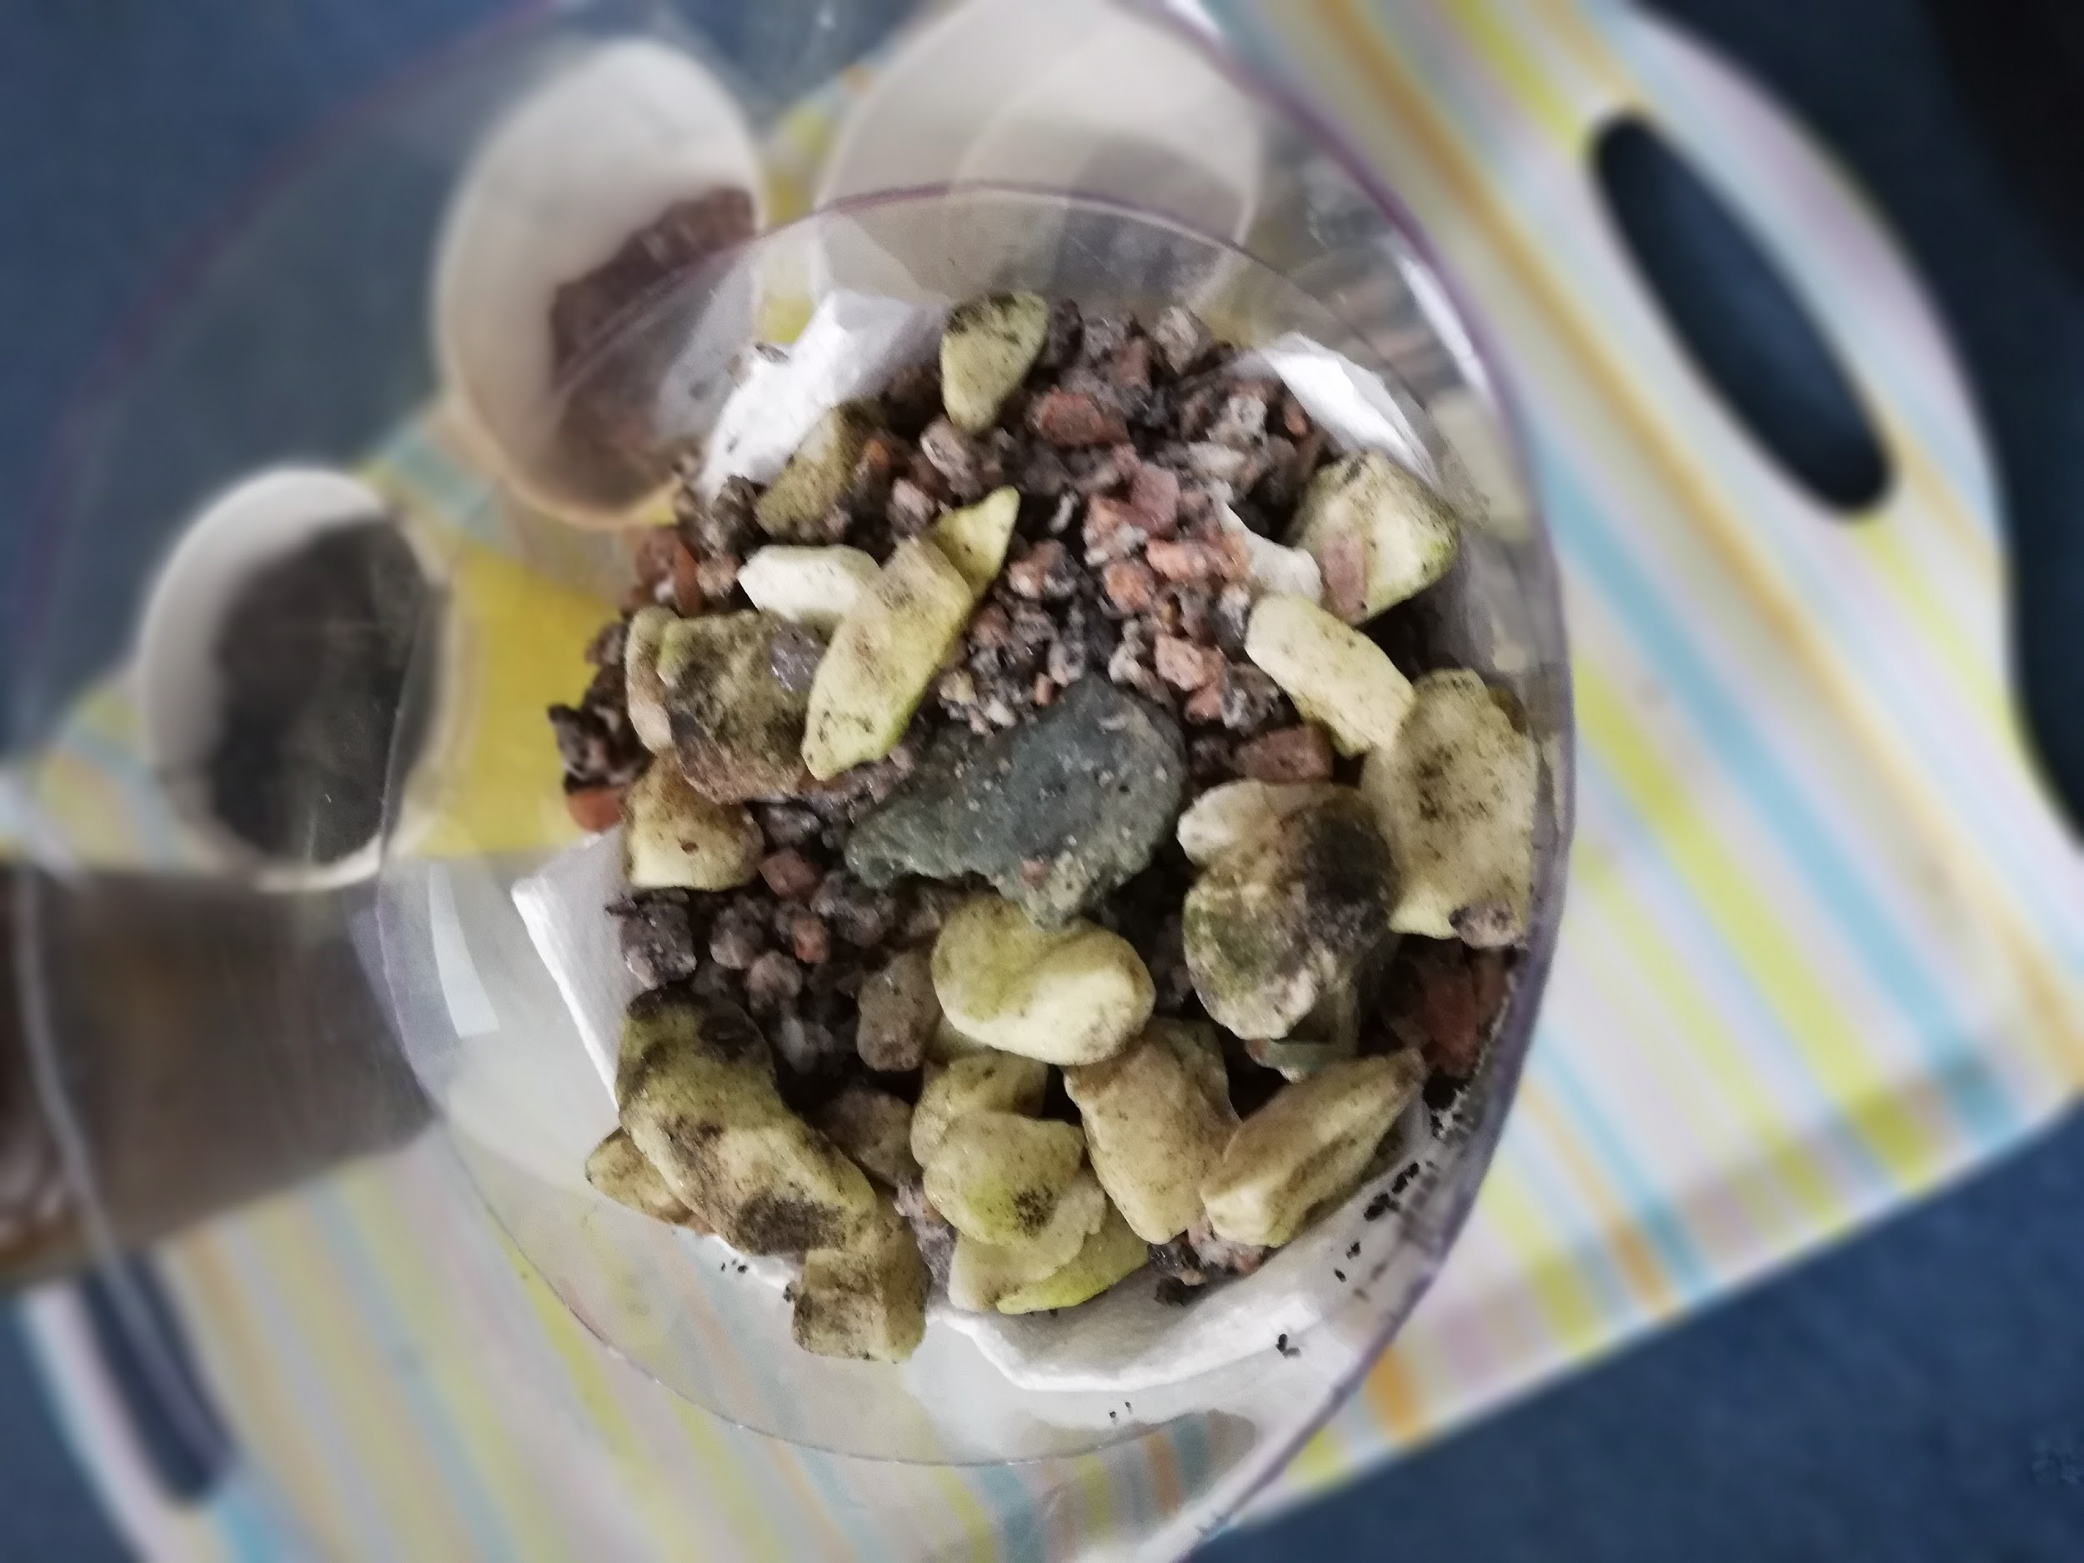
Start to layer the different things
I did:
Cotton wool pads
Kitchen roll
Soil
Sand
Gravel
But you can try different combinations!!

Slide 6
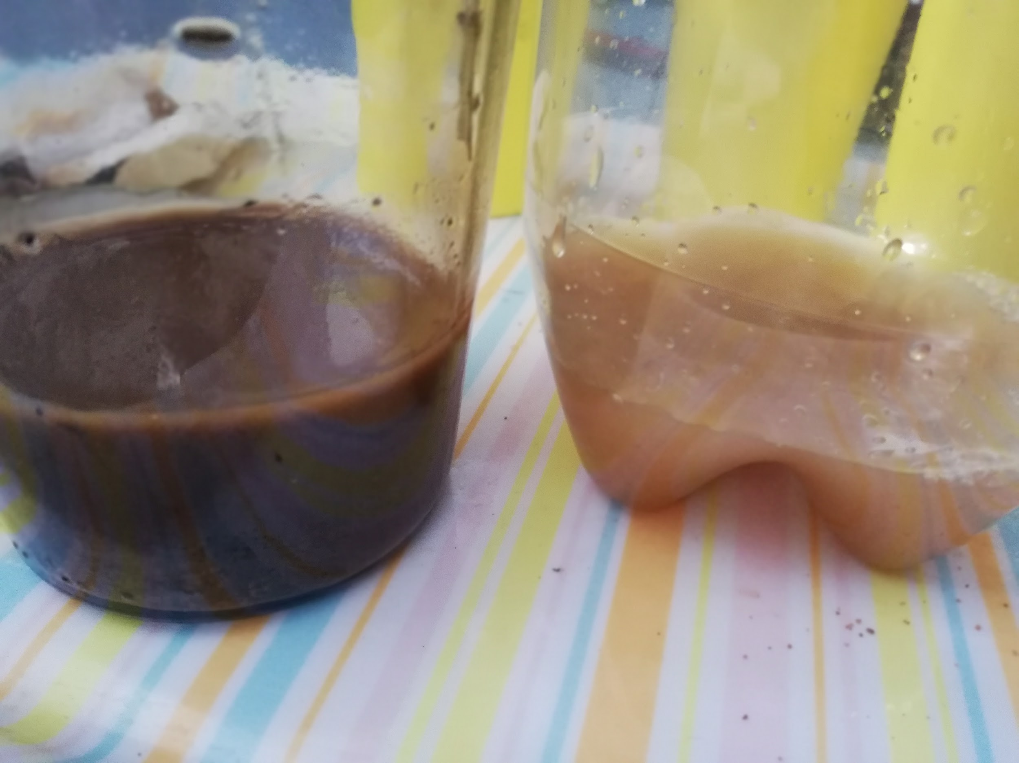
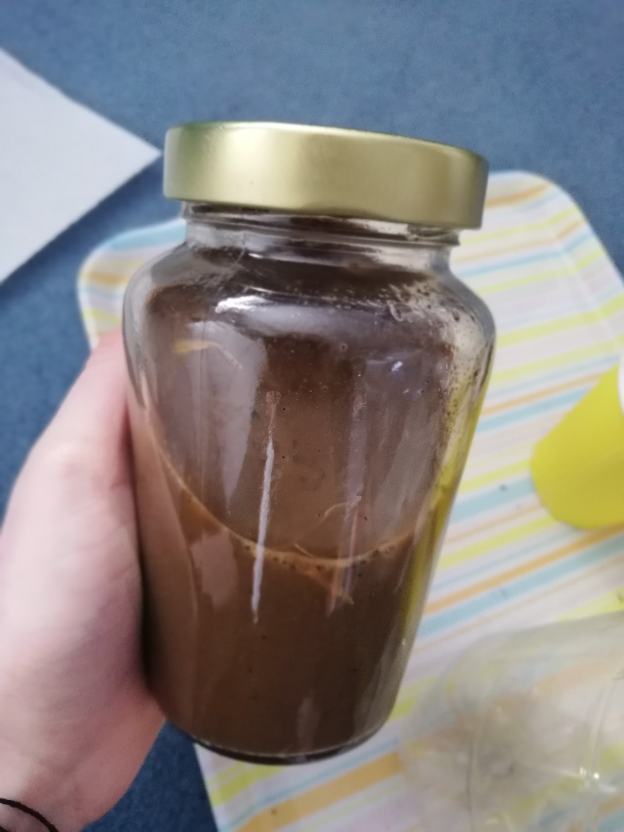
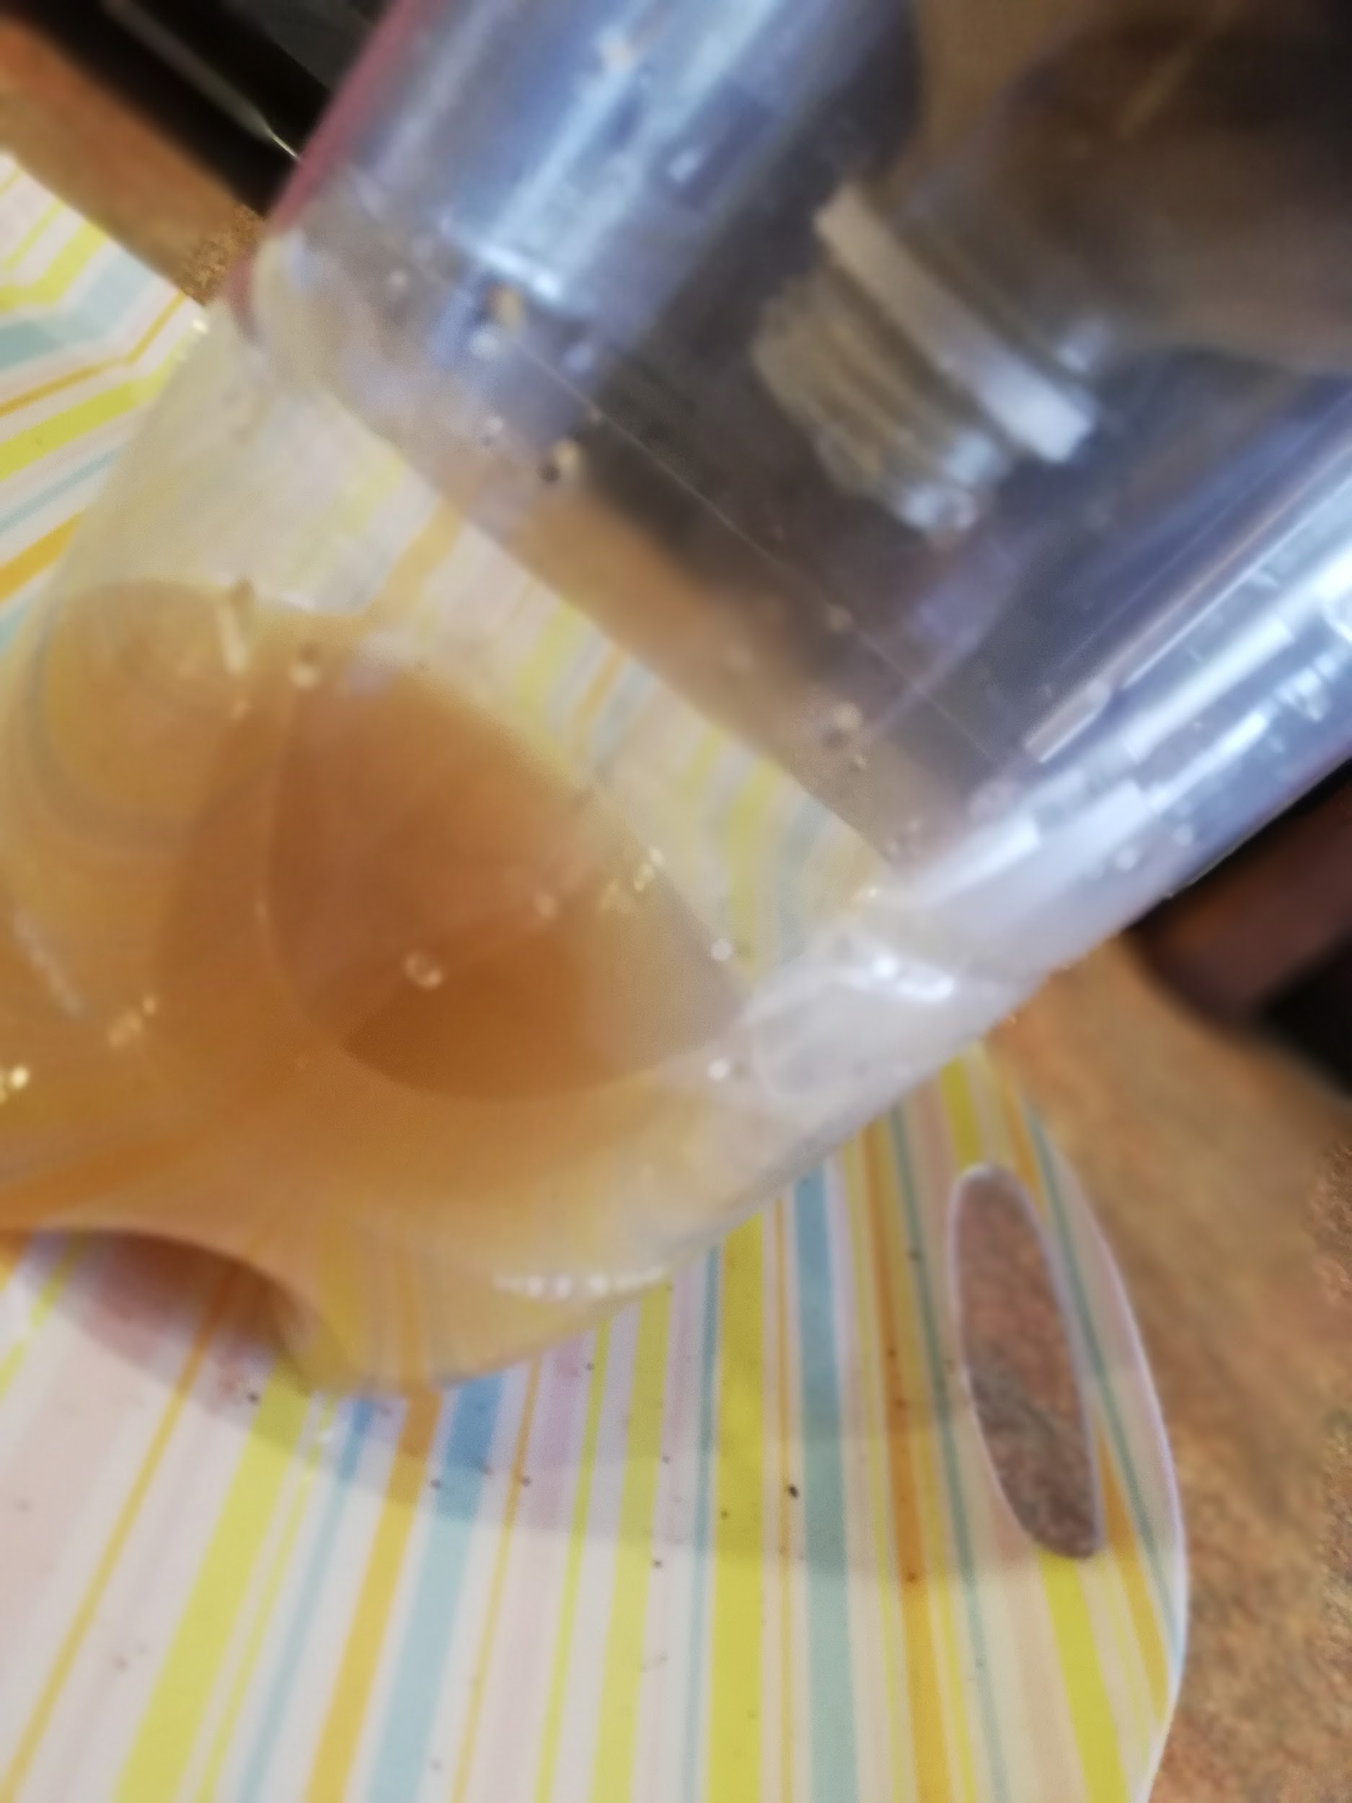
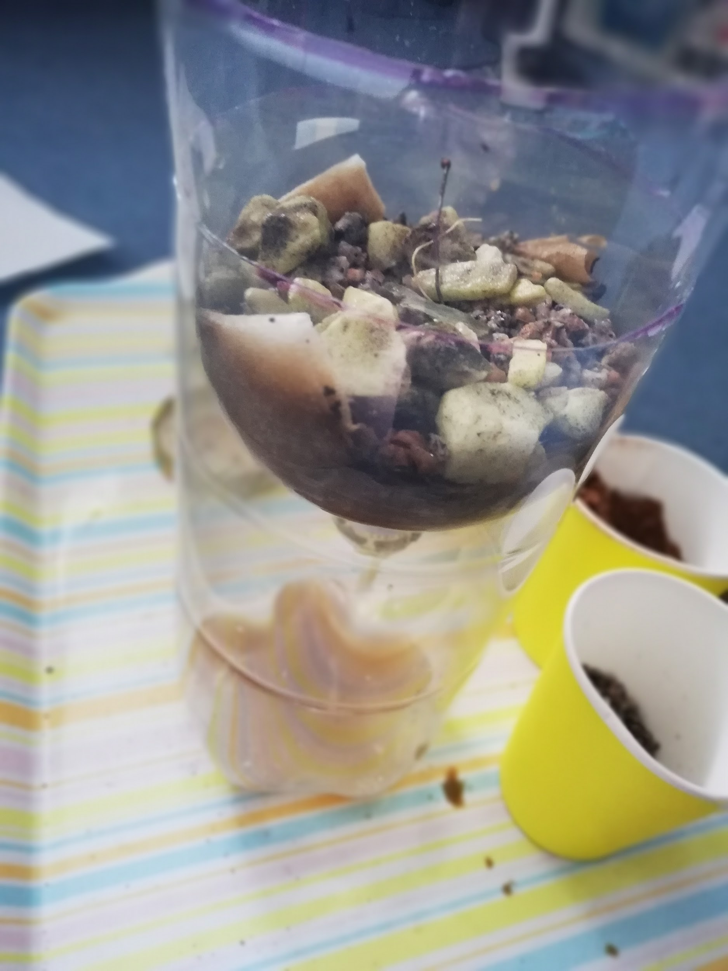
Pour your muddy water in and see if it works!!
Mine kind of worked, if I put the water through again it would be more clean
Once you have clean water you can use water purification tablets to get rid of any nasty bacteria

